Slide 1
A Smarter, Flexible Way to Stay Fit
Tag line: If you move today, you are better than the other half of America that didn’t move! TO BE CHANGED

Slide 2
The Problem
Time: Most fitness programs assume 45–60 minutes and rigid schedules, causing busy people to miss workouts, lose progress, and eventually give up.
Motivation: Exercise isn’t sustainable if it isn’t enjoyable—workouts must be intrinsically rewarding to become a lasting habit.
Resources: Personal training and gyms are costly and confusing, leaving most people without affordable, personalized guidance that actually fits their needs.
 | Meet John | Meet Nick
Who they are | Father of two toddlers, holds a full-time job | Associate at BCG
Goals | Set a good example, play sports with his kids | Stay healthy, reduce stress, look a little better
Challenge | Unpredictable schedule, variable sleep & stress, varied equipment access
Current Solution | Finds workouts online, runs, has used apps in the past | Had a trainer, follows programs off and on, makes up his own
Gaps in Current Solutions | Workouts do not adjust to match sleep and stress, lack time and equipment flexibility, do not adapt to preferences, get stale and become a chore

Slide 3
Meet our App
Our Insight:
Consistency beats intensity
Enjoyment drives adherence
Flexibility is key!
The Solution: A workout app that…
Personalizes workouts based on your history and preferences
Provides immediate time and equipment flexibility
Moderates' intensity based on sleep and energy levels
Adjusts for aches/pains and injuries
Free Version
Unlimited workouts
Warm-ups
Personalized workout based on preferences, equipment, time, etc.
Post-Workout stretching
Scaling options and intra-workout movement substitutes
History
Saves all workouts
Paid Version ($15 per Month) adds on…
Long-term plan & periodization
Ingests broad goals and builds long-term plan based on lifestyle
Adjusts daily workouts based on your schedule & available equipment
Integrations
Heart-rate monitors, Whoops, Apple Watches
Other programs (Crossfit, Powerlifting, etc.)
Education
Rehab for minor aches and pains
In-depth explanations into the why behind the programing
Social
Option to connect with other users and find gym buddies based on your workout preferences

Slide 4
Our App is built for two distinct customer segments with very similar pain points and needs
Our Customers
High-Intensity Working Professionals
470k estimated potential customers
Who they are
Age 22–40, early-career
High amounts of travel
Highly educated, high or rising income
Reality
Extremely unpredictable schedules
High cognitive load and pressure
Time-poor, but highly disciplined
Willing to pay to save time and reduce decision-making
Core pain
No consistent time to work out
Don’t want to plan or program their own workouts
Missed workouts feel like failure / loss of control
Rigid programs that assume predictability
What resonates
• Control without planning
• Discipline without rigidity
• Consistency without guilt

Slide 5
Our marketing plan will focus on three main channels to access our target audience
Marketing
Hotels
Place QR codes linked to our App in franchise owned hotels with fitness centers that cater to business travelers
Cost: None
Estimated Yield: 30-50 downloads, 3-5 paid users per hotel per month
First 3 Monts: Place QR Codes in 6 hotel gyms
Reach: New customers ever day -
Apartment Buildings
Place QR codes linked to our App in high-rise apartments with fitness centers and at least 200 residents
Cost: None
Estimated Yield: 6-12 downloads, 1-3 paid users per building
First 3 Monts: Place QR Codes in 50 apartment gyms
Social Media
Both paid and user generated content aimed at our target customer segments
Cost:
First 3 Months: A/B adds with target segments to refine messaging
 | Seg. 1 | Seg. 2
$ / Thousand Views | $ 20.00 | $ 12.00
Click Through Rate | 1.0% | 1.0%
$ / Click | $ 2.00 | $ 1.20
Install Rate | 30% | 25%
$ / Install | $ 6.67 | $ 4.80
Conv. Rate | 10% | 5%
$ Per Paid User | $66.67 | $96.00

Slide 6
Expansion Opportunity
Our product roadmap is aimed at:
Serving our customers as they evolve along their fitness journeys (increasing workout programing and sophistication)
Catering to a broader set of needs and preferences within our customer segment (yoga, postpartum, nutrition)
Creating sticky customer relationships (social, youth)
Paid +
Specific performance plans (youth + adult athletes)
Expanded rehab (serious injuries)
In-depth Nutrition (micro-nutrient recommendations)
Human Consultants
Capability Expansion
Yoga
Youth (join mom in her morning workout!)
Postpartum
Nutrition (Macros + Calories, Meal Planning)
MVP
Unlimited personalized Circuit workouts
Saved History
Paid Core
Long-term Strength / Conditioning plans
Integrations
Rehab
Social

Slide 7
Market Opportunity
We are starting off with a very specific customer segment in order to dominate this category, gain traction, learn about our customer’s preferences before expanding into larger market segments
Table with Initial Customer Acquisition Channels and revenue + Fixed
Young professionals sliver showing our initial market segment

Slide 8
Competitive Landscape
App | Founded | Strength | Weakness / Gap | Fitness Expertise
Freeletics | 2013 | High enjoyment via intensity and structure | Still relatively static and demanding – limited flexibility | Limited to none, no certified trainers listed
Fitbod | 2015 | Strong on adaptability and data | Still framed around “training” rather than lifestyle enjoyment | One certified trainer acts as an advisor
FitnessAI | 2019 | AI-driven personalized workouts | Training-centric, limited breadth — not lifestyle oriented | Limited to none, no certified trainers listed
Ladder | 2020 | More enjoyable and coach-driven | Locked into structured programs; less real-time adaptability (iOS focus historically) | High expertise, multiple certified trainers listed
MAPS |  | High variety of of workouts, equipment flexibility | Option paralysis, minimal flexibility within programs | High expertise, built by strength coaches

Slide 9
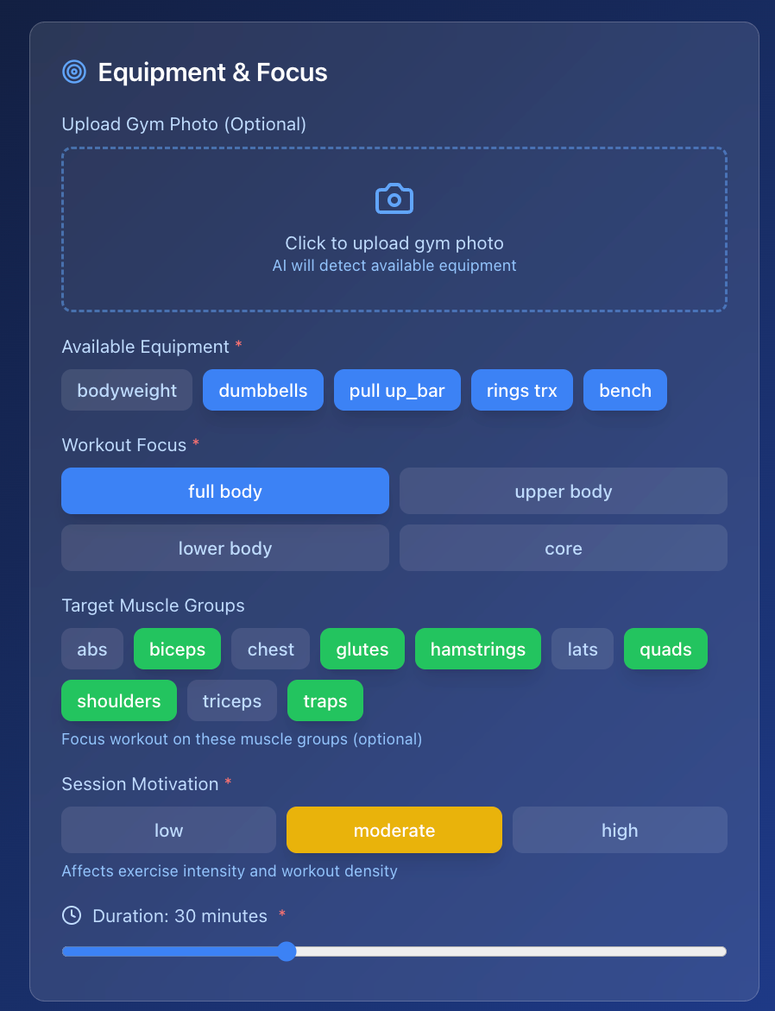
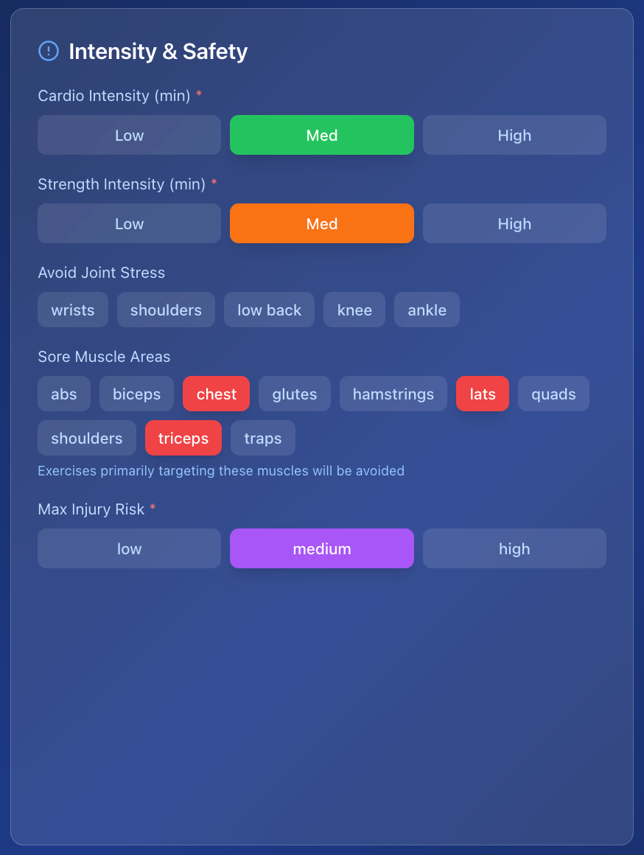
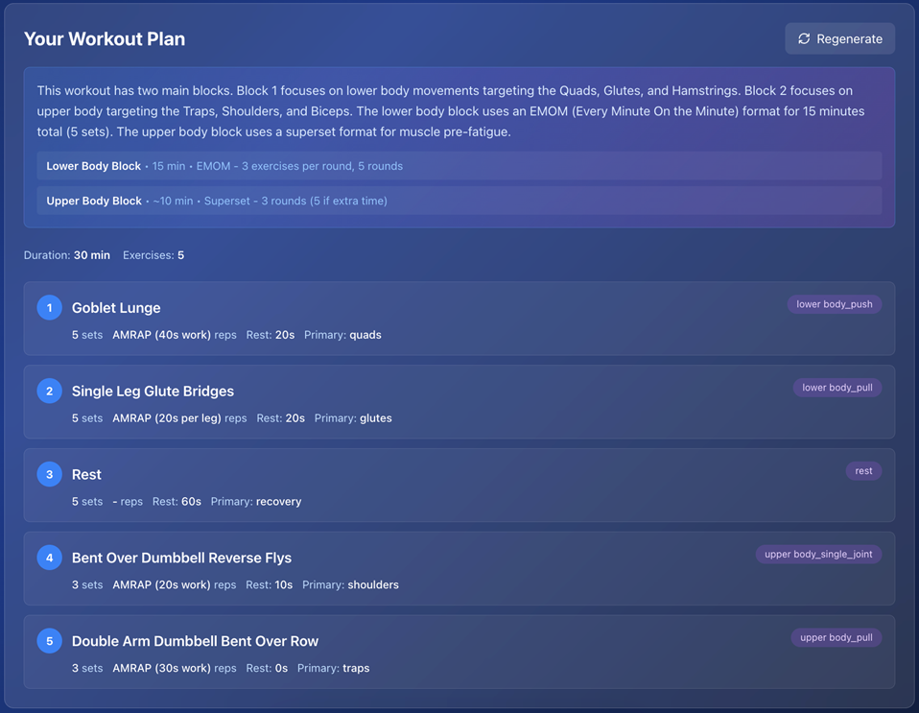
User Interface

Slide 10
Why We Win
Fitness designed for real life.
• Adaptive
• Enjoyable
• Sustainable

